Slide 1
EPICS 7
Kay Kasemir, June 2019

Slide 2
EPICS 7 =
EPICS ‘base’
Records, Device Support,
Channel Access, softIoc
Almost like R3.13 from 1994
EPICS ‘V4’
PVAccess,
softIocPVA Started ~2010
+
Available since Dec. 2017

Slide 3
EPICS 7 ?
Revolutionizes EPICS
Everything is
Easier
Faster
More colorful
Service-oriented
Kills EPICS as you know it
Services replace IOCs
Channel Access clients no longer connect
Breaks your device support
Needs more CPU & Memory

Slide 4
Now What?
Use EPICS as before
No need to change anything
Look at ‘RELEASE.local’ mechanism
Support for 64bit numbers, SMP, locking tweaks
Start to use PV Access
Images
Custom structures
Transition everything to PV Access
.. Once there’s a PVA Gateway, access security, everything “works”

Slide 5
EPICS Base
Records, device support, databases, sequences, … as before
Modules encouraged to use RELEASE.local
XXX/configure/RELEASE
ASYN=/path/to/asyn1-2-3 EPICS_BASE=…
XXX/configure/RELEASE
-include $(TOP)/../RELEASE.local
YYY/configure/RELEASE
-include $(TOP)/../RELEASE.local
YYY/configure/RELEASE
AUTOSAVE=/path/to/auto1-2-3 EPICS_BASE=…
RELEASE.local
ASYN=/path/to/asyn1-2-3 AUTOSAVE=/path/to/auto1-2-3 … EPICS_BASE=…

Slide 6
RELEASE.local in Training Setup
cd ~/epics-train/tools
ls –d base* seq* asyn*
cat RELEASE.local
cat seq*/configure/RELEASE

Slide 7
PV Access
How does it differ from Channel Access?
How do I…
… add PVA to an IOC?
… ‘caget’ with PVA?
… use PVA in UI tools (Operator Displays, ..)?
Area Detector: Any advantage using PVA?
Custom Data: Any advantage using PVA?
Some Python Examples

Slide 8
History
Channel Access
Since beginning of EPICS
DBR_*: Numbers, enums, string, scalar and array, with time, alarm, limits
Still fully supported
PV Access
Started as “EPICS V4” development
PV Data: Arbitrary structures
Since EPICS 7 (Dec. 2017) included in EPICS base

Slide 9
Review Channel Access
cd ~/epics-train/examples/first_steps cat first.db softIoc –m S=training –d first.db
echo $EPICS_CA_ADDR_LIST caget training:random camonitor training:random
cainfo training:random caget –h caget –d DBR_CTRL_DOUBLE training:random
cainfo training:random.SCAN caget –d DBR_CTRL_ENUM training:random.SCAN

Slide 10
How Clients find Channels
Wants to read "PS1:Voltage"
Client
Client
Client
Client
Client
Client
Channel Access
IOC
IOC
IOC
IOC
Meter
Power Supply
Camera
Has PV "PS1:Voltage"

Slide 11
Important Environment Variables
EPICS_CA_ADDR_LIST
Determines where to search
Is a list (separated by spaces)
“123.45.1.255 123.45.2.14 123.45.2.108”
Default is broadcast addresses of all interfaces on the host
Works when servers are on same subnet as Clients
Broadcast address
Goes to all servers on a subnet
Example: 123.45.1.255
Use `ifconfig –a` on UNIX to find it
EPICS_CA_AUTO_ADDR_LIST
YES: Include default addresses above in searches
NO: Do not search on default addresses
If you set EPICS_CA_ADDR_LIST, usually set this to NO

Slide 12
Channel Properties
Each channel comes with properties:
Value
of type string or double or int or …
Scalar or array
Time stamp
Up to nanosecond precision
Severity code
OK, MINOR, MAJOR, or INVALID
Status code to qualify the severity
OK, READ error, WRITE error, at HIGH limit, …
units, suggested display range, control limits, alarm limits.

Slide 13
Client interface to properties
The available properties are fixed.
One cannot add a new 'color' property.
The request types are fixed.
"DBR_…" types.
Available:
Just value.
Value with status and severity.
Value with status, severity and time stamp.
Almost Everything: Value, units, status, limits, … but time
Not available:
Custom combinations like value, precision, units.
See `caget –h`

Slide 14
Example: AI record "fred"
PV "fred" or "fred.VAL"
value property of channel = VAL field of record.
Type double, one element (scalar).
time property = TIME field
status = STAT
Severity = SEVR
units = EGU
Precision = PREC
display limit low, high = LOPR, HOPR
control limit low, high = LOPR, HOPR
alarm limits = LOLO, LOW, HIGH, HIHI
Makes a lot of sense.
GUI can display the value together with units, formatted according to the precision, as e.g. "12.37 volts”.

Slide 15
Example: AI record "fred"
PV "fred.SCAN"
value property of channel = SCAN field of record.
Type enumerated, values: "Passive", "1 second", ...
time property = TIME field?
status = STAT?
Severity = SEVR?
control limit low, high = 0, ??

Slide 16
How is PV Access different?
cd epics-train/examples cat first.db softIocPVA –m S=training –d first.db
echo $EPICS_PVA_ADDR_LIST pvget training:random pvmonitor training:random pvget –m training:random
pvinfo training:random pvinfo training:random.SCAN

Slide 17
Channel Access vs. PV Access
Similar command line tools:
﻿start_iocExample
cainfo training:ai1
caget training:ai1
camonitor training:ai1
caget –d CTRL_DOUBLE training:ai
caget training:ai1.SCAN
pvinfo training:ai1
pvget training:ai1
pvmonitor training:ai pvget –m training:ai1
pvget –v -r 'field()' training:ai1
pvget training:ai1.SCAN

Slide 18
PV Access
Fundamentally similar to Channel Access
Name search via UDP
Connection for data transfer via TCP
EPICS_PVA_ADDR_LIST, EPICS_PVA_AUTO_ADDR_LIST
Get, put, monitor
Plus ‘GetPut’, ’PutGet’, ‘RPC’ type operations
Arbitrary PV Data structures instead of DBR_.. types

Slide 19
Arbitrary Data: Great, but then what?
structure: short level double data string type time stamp …
structure: short level double wert string typ long zeit …
structure: double value short status short severity string units time timeStamp …
Which number to show on a user display?
What units?
Is this an alarm?
Time stamp?
structure: short info double content string meta long ms …

Slide 20
“Normative Types”
Channel Access
struct dbr_ctrl_double: short status short severity short precision char units[8] … no timestamp … double value struct dbr_time_double: short status short severity timestamp stamp double value
You get what you request (network always transfers complete struct)
PV Access
epics:nt/NTScalar: double value short status short severity string units time timeStamp …
You get what you request (but network only transfers changes)

Slide 21
Channel Access vs. PV Access in UI Tools

Slide 22
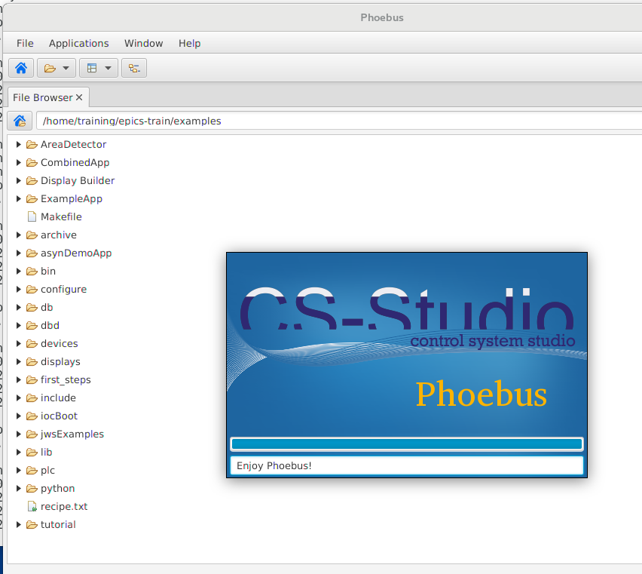
Getting Started with CSS
Start `css`

Slide 23
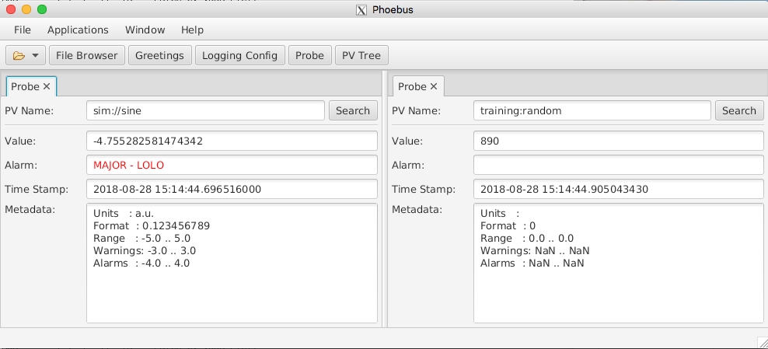
Probe
Open Menu Applications, Display, Probe
Enter PV name “sim://sine”
Open another Probe for “training:random” (or some other PV from your IOC)
Close Probe
Open it again
Note previously used PVs in history as you enter new PV
Right-click on the “Probe” tab, Select “Split Horizontally”, and move one of the probes to new panel.

Slide 24
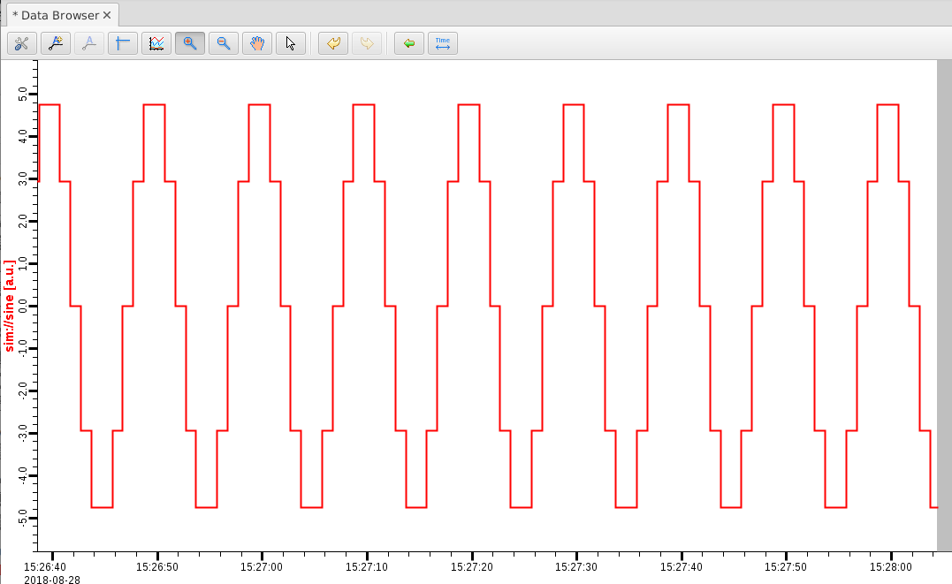
Data Browser
Menu Applications, Display, Data Browser
Right-click on plot, Add PV, “sim://sine”
Wait a little, press Stagger button, then zoom and select a region on the time axis

Slide 25
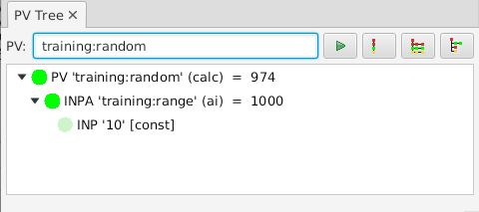
PV Tree
Menu Applications, Display, PV Tree
Enter a PV from an IOC, like “training:random”

Slide 26
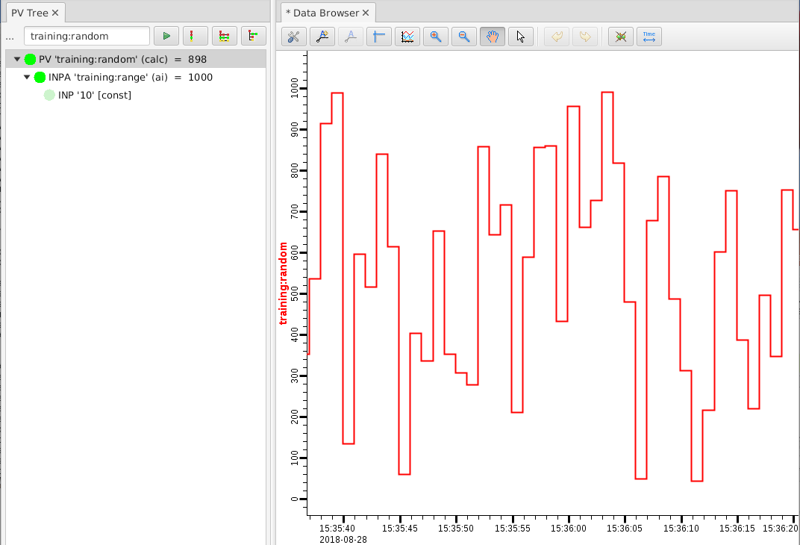
CSS PV Exchange
PV in any CSS Tool ➔ Context Menu ➔ Select other PV Tool
Try:
Right-click on item in PV Tree, select Data Browser

Slide 27
CS-Studio: Use ‘pva://…’
For now, just “pvname” is same as “ca://pvname”. “pva://” selects PV Access. Eventually, that could become the default.

Slide 28
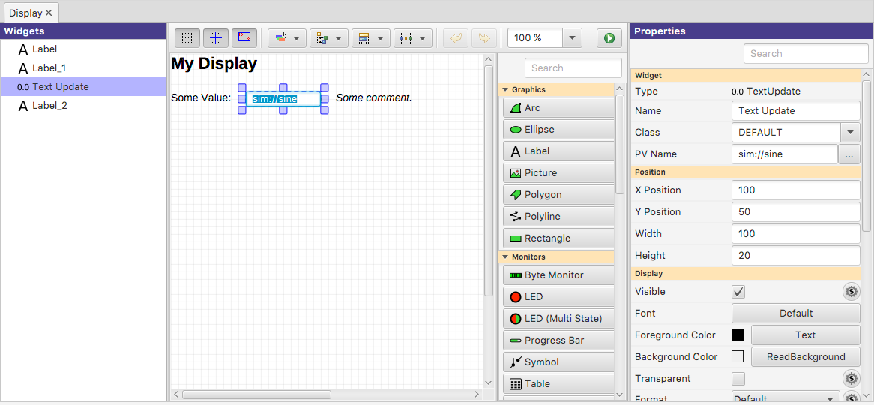
Create New Display
Menu Applications, Display, New Display
Enter a name with .bob file extension
Property Panel Edit properties of selected widgets
Save & Execute the Display
Main Editor Area Select Widgets Move, resize widgets Ctrl-C, V, X to copy, paste, delete (⌘ on Mac)

Slide 29
Editing a Display
Widget Palette Drag widget into editor
- or -
1) Select Widget Type
2) Draw rectangular area in display
Selecting Widgets a) Click single widget
b) Ctrl-click to add widget (⌘ on Mac)
c) Drag ‘rubberband’ around widgets
d) Click or Ctrl/ ⌘ click in widget list
Quick Edit Double-click widget to
a) Edit text of Label
b) Edit PV of widgets that use a PV

Slide 30
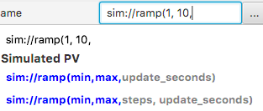
Extend the First Display
Drag a “Text Update” from the palette
Enter PV name “sim://ramp(1, 10, 1)”. Note PV name auto-completion popup.
Add “Boolean Button”
PV name “loc://test”
Add “LED”
PV name “loc://test”. Note name in PV History.
Execute the display
Toolbar Button or Context Menu

Slide 31
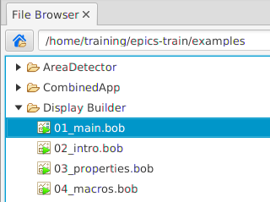
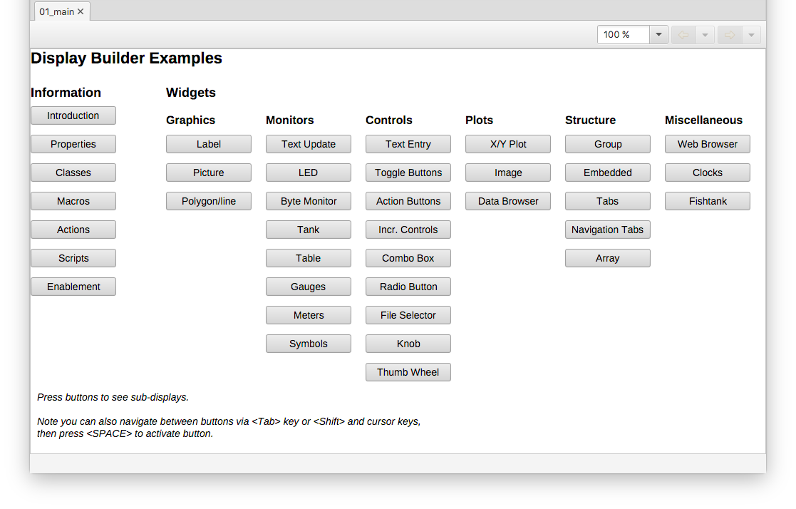
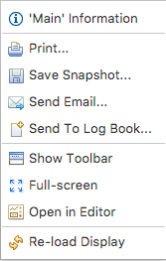
Browse the Display Examples
Training setup: Open /home/training/epics-train/examples/Display Builder/01_main.bob
Fresh CS-Studio Setup: Applications, Display, Examples, Install Example Displays
Try all of them..
Context Menu: Open in Editor to inspect how it’s done

Slide 32
How is PV Access different? Images!
start_imagedemo pvinfo IMAGE # CSS displays/PVA_Image.bob

Slide 33
Area Detector
Disclaimer:
This will only scratch the surface.
EPICS web site has several days of training material if you are serious about using the A.D.

Slide 34
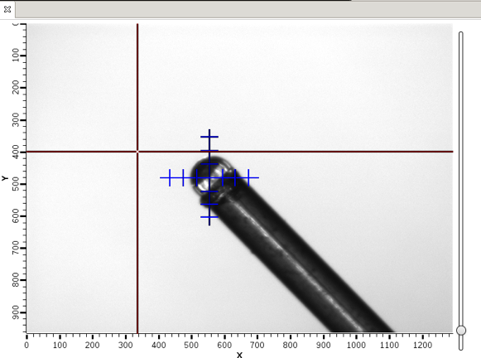
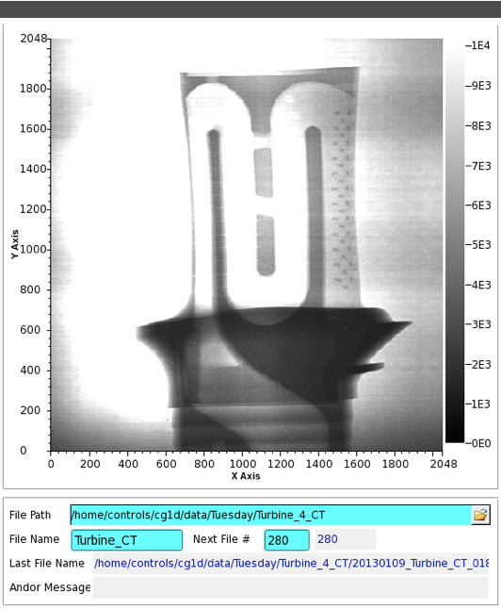
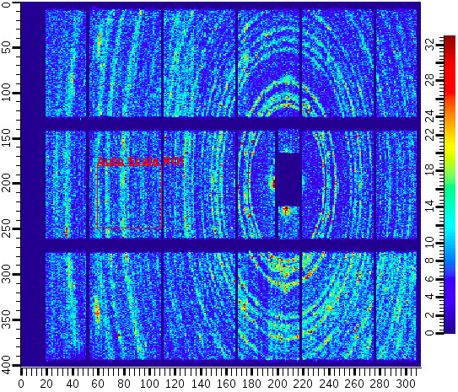
Area Detector
EPICS framework for image manipulation
Detectors/Cameras
Cheap “Web Cam”
$$$ high speed, high res.
Neutron, X-Ray detectors
Plugins collection
ROI
Transform
ColorConvert
Etc.

Slide 35
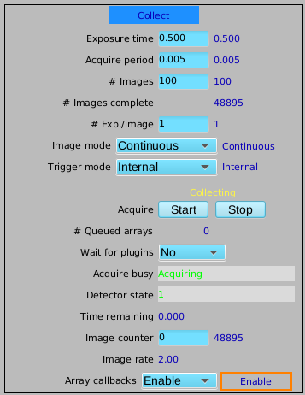
ADSimDetector
Simulated images
cd ~/epics-train/examples/AreaDetector ./start_sim_ioc.sh
Open the AreaDetectorDemo.bob
On “Detector” page, “Start” the SIM1 detector
By itself, this creates an Area Detector port “SIM1”. To see it, need to publish via CA or PVA

Slide 36
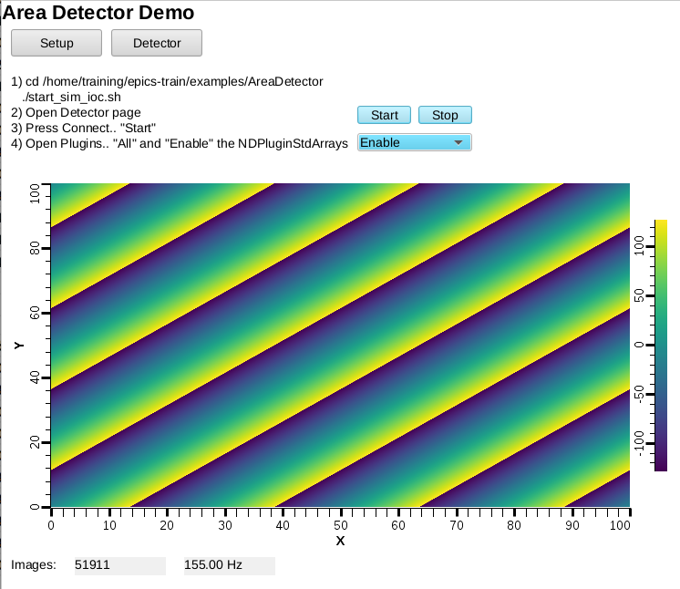
NDPluginStdArrays
Serves image as Channel Access waveform
On Detector, Plugins, All, find NDPluginStdArrays
Port = “SIM1”
Enable
AreaDetectorDemo.bob shows image
PV: 13SIM1:image1:ArrayData
Width x Height: 1024 x 1024
Unsigned

Slide 37
NDPluginOverlay
Adds rectangles, text etc. to image
On Detector, Plugins, All, find NDPluginOverlay “OVER1”
Set its Port to “SIM1”, Enable
Change NDPluginStdArrays’s Port to “OVER1”
Press “More”, select first of the “Individual Overlays”

Slide 38
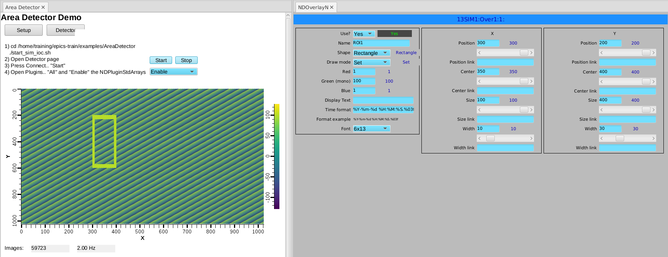
NDPluginOverlay.. Overlay #1
Set Use: Yes, Shape: Rectangle, set X and Y as shown

Slide 39
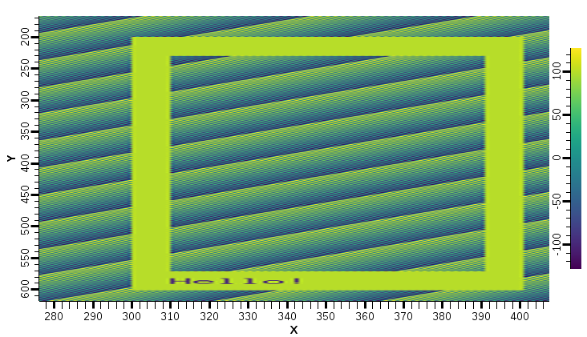
What we did
Area Detector IOC
Image1
Plugins
OVER1
OVER1 offers 8 overlays:
Rectangle
Text “Hello”
…
SIM1
Driver

Slide 40
Many More Plugins…
Process
Background subtraction, clipping, recursive averaging over N images, ..
Saving images in various formats
Adding data from PVs as “Attributes”
PNG, JPEG, TIFF, HDF5, …
Serving NDArray via PVA
For displays: No need to configure size, data type, …
For ADPvAccess Driver: Process data on different hosts

Slide 41
NDPluginPVA – Serve PVA ‘Image’
In Plugins, “PVA1”
Set its Port to “SIM1” or “OVER1”, Enable
PVAccess Tests
pvinfo 13SIM1:Pva1:Image
pvget -r 'dimension' 13SIM1:Pva1:Image
In Display
Use “Image” widget
Set PV
No need to configure data size, data type

Slide 42
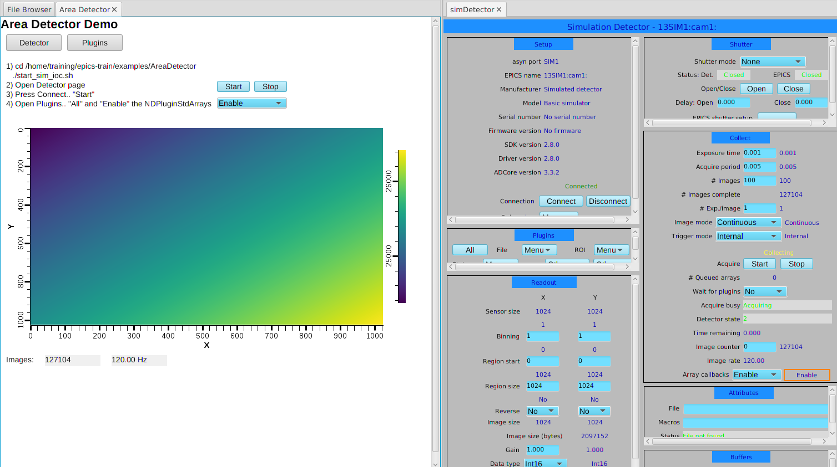
NDPluginPVA – Serve PVA ‘Image’
Display adapts to image size

Slide 43
How is PV Access different? Custom Data!

Slide 44
Custom PV Data
SNS Beam Lines started to use this in ~2014
start_neutrondemo
pvinfo neutrons
Allows fetching just what’s needed:
# For detector pixel display pvget -r 'field(pixel)' neutrons pvget –m -r 'field(timeStamp, pixel)' neutrons
# For energy displays pvget –m -r 'field(time_of_flight, pixel)' neutrons

Slide 45
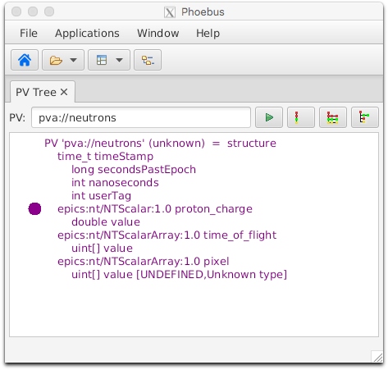
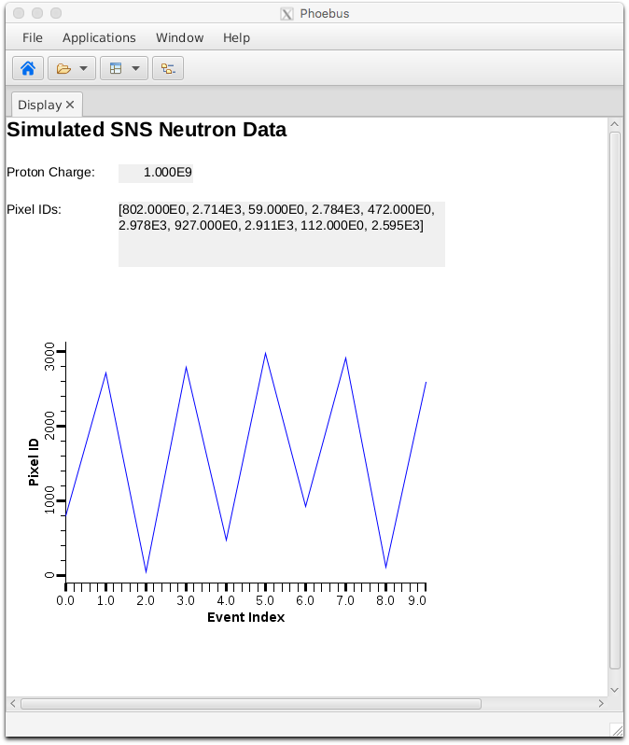
Custom PV Data in CS-Studio
Cannot handle arbitrary structure
pva://neutrons
Can handle fields which are scalar or array
pva://neutrons/proton_charge
pva://neutrons/pixel

Slide 46
Custom PV Data from IOC Records
`makeBaseApp.pl –t example` includes “group”, see ~/epics-train/examples/ExampleApp/Db/circle.db
Calc records ..:circle:x & ..:circle:y compute (x, y) coordinate on circle
info() annotations create PV ”training:circle” PV as struct { angle, x, y }
PVA “training:circle” updates atomically
camonitor training:circle:x training:circle:y separate x, y updates pvget –m training:circle will always see sqrt(x²+y²)==1
cd ~/epics-train/examples/python python circle.py

Slide 47
Python

Slide 48
PV Access and Python
start_iocExample
Basic ‘get’
cd ~/epics-train/examples/python/
python example1.py
‘monitor’
python example2.py

Slide 49
Custom PV Data in Python Client
Python receives data as dictionary, access to any element
python neutrons.py

Slide 50
Custom PV Data from Python Server
Surprisingly easy:
# Server
python server.py
# Client
pvinfo pair
pvget -m -r "x, y" pair
pv = PvObject({'x': INT, 'y' : INT})
server = PvaServer('pair', pv)
x = 1
while True:
pv['x'] = x
pv['y'] = 2*x
server.update(pv)
sleep(1)
x = x + 1

Slide 51
More Examples
Display Builder pva_server_ramp
Python code that serves ‘pva://ramp’ with alarm, prec, timestamp, …
Display Builder table_server
Python code that serves ‘pva://table’ as “NTTable”
Impractical to replace all regular IOCs with python, but useful when custom data is needed

Slide 52
Ongoing Work
PVA Gateway
Access Security
Normative Type details: ‘format’, precision, …
Database: Support PVA links. field(INP, “pva://other_record”)

Slide 53
EPICS 7
EPICS ‘base’
Records, Device Support,
Channel Access, softIoc
EPICS ‘V4’
PVAccess,
softIocPVA
+
No need to worry about existing R3.x setups
You may start using PVAccess
Images
Custom Data
Good Python support
CS-Studio is one of the early ‘bilingual’ tools

